Slide 1
Classifying Mask Sentiment Overtime
Name: Manda Bucklin
School: New College of Florida
Major: Data Science: Class 2021
Directors: Patrick Biltgen & Andrew Howard

Slide 2
Project Introduction
Intro: from fake news to COVID masks
Project Goal:
Visualize sentiment on COVID masks from beginning of pandemic to present
Classify text about COVID masks
Yes, No, or Neutral
Company, Government, General, Healthcare, Institution, Location, & Public
Why focus on Florida?:
Top 3 highest COVID cases in U.S.
I live in Tampa (but am COVID free ☺)

Slide 3
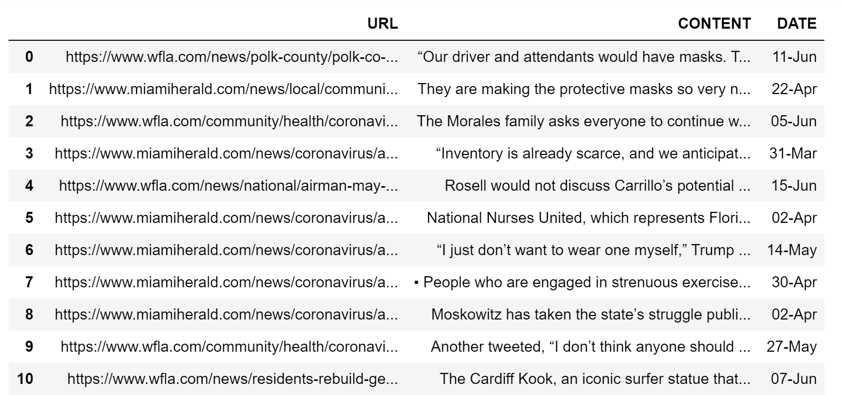
The Dataset
Created Dataset
Why?
No current text dataset on COVID masks
I wanted to satisfy my curiosity on sentiment of COVID masks
Process
I scraped content on prominent Florida news sites by filtering/searching the word “masks” on those sites.
Miami Herald, Orlando Sentinel, WFLA, WUFT, FL Keys News, Tampa Bay Times, and Sun Sentinel
The Data
URL of Article
Content
Title
Date

Slide 4
The Dataset
Things to keep in mind:
Repetition
Almost identical articles written by different news entities.
Specific events skew the data
Each news source wrote of this event multiple times.
One situation being represented multiple times
i.e. Trump, Publix, & 3M examples
News Sources
Each news source is not represented equally
Skew of content (and thus labels) from specific sources/perspectives
Size
The dataset is not very large
Labeling
Labeling is hard – not black and white

Slide 5
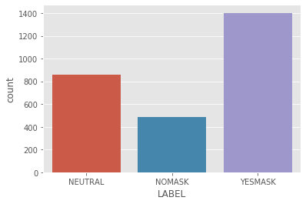
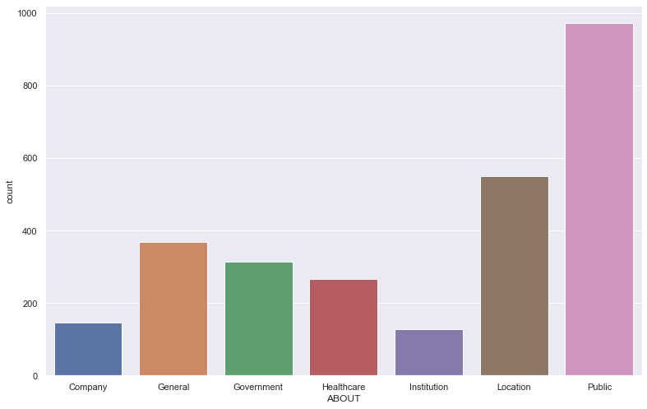
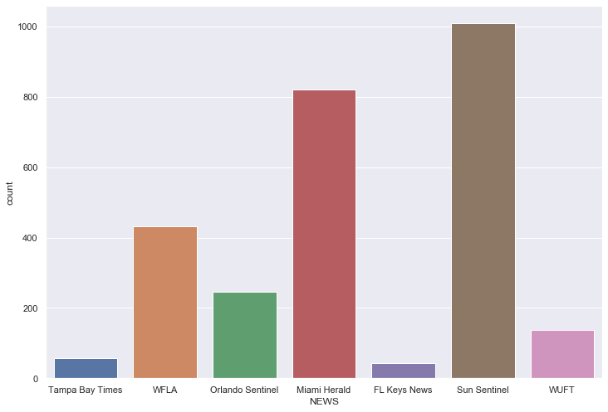
EDA on Dataset

Slide 6
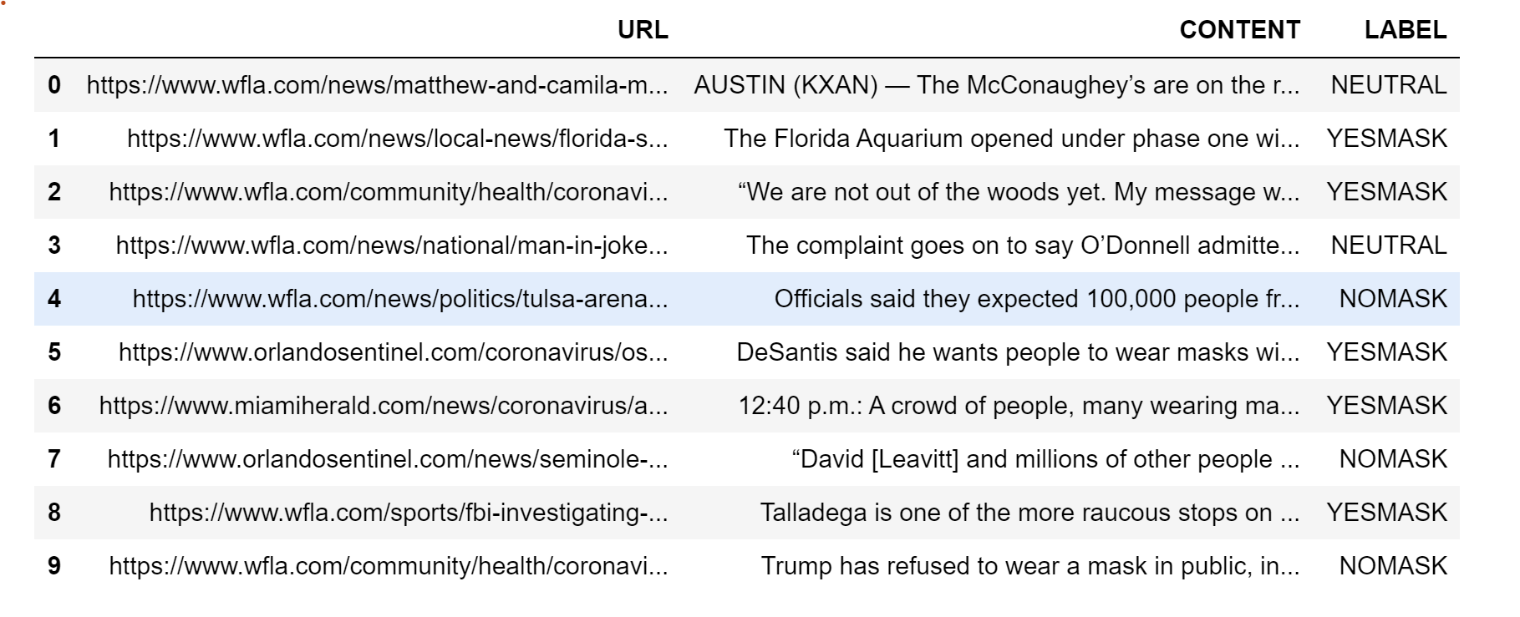
Breakdown the Data
Filter data to content that only includes the word “mask”
Next, I labeled each piece of content as “YesMask”, “NoMask”, or “Neutral”
YesMask
Content encourages or supports people wearing masks
NoMask
Content discourages or has a negative outlook on wearing masks
Neutral
Content contains fact statements about masks or statement includes both positive/negative outlook on masks.

Slide 7
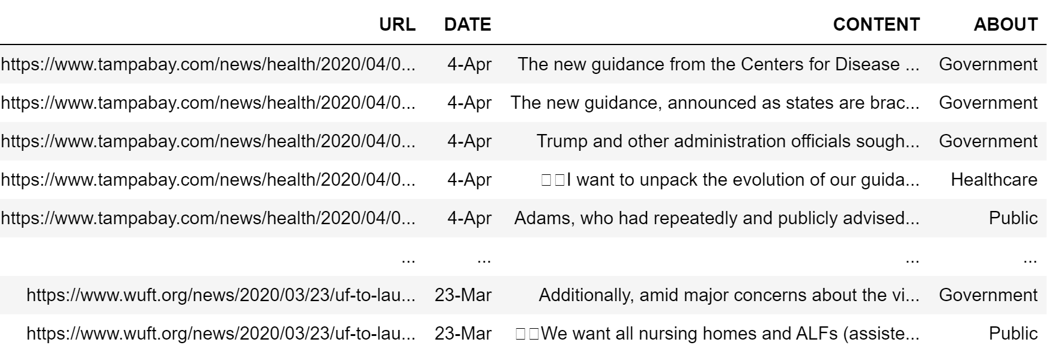
Breakdown the Data - cont’d
Company
3M, Disney, Publix, Costco, airlines, etc.
Government
CDC, Trump, DeSantis, Biden, Fauci, etc.
Healthcare
Nurse, hospital, doctor, physician, etc.
Institution
Prison, police, universities, school, etc.
Location
Tulsa, Flint, New York, FL cities & counties, etc
Public
Business, mall, restaurant, crowd, people, etc.
General
Content that did not fall into any other category

Slide 8
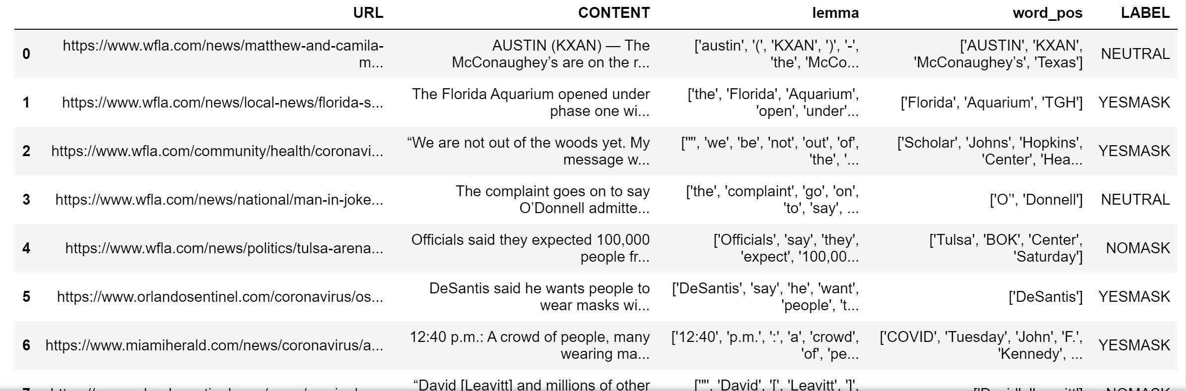
NLP & Lemmatization
Stanford NLP
I had not used before. Stanford NLP to break down sentences into particular labels for me to process data eaiser
Lemma Column - Lemmatization
Converting a word to its base form. This involves grouping together different inflected forms of a word, while still keeping the context of the word. Words with multiple variations, but with similar meanings, can be analysed as a single item. An example of this is "better" to "good", "saying" to "say", and "heard" to "hear".
Word_Pos Column
Word_pos column, in this code, pulls out all proper nouns. This is so that I can pull out people and locations later on for analysis

Slide 9
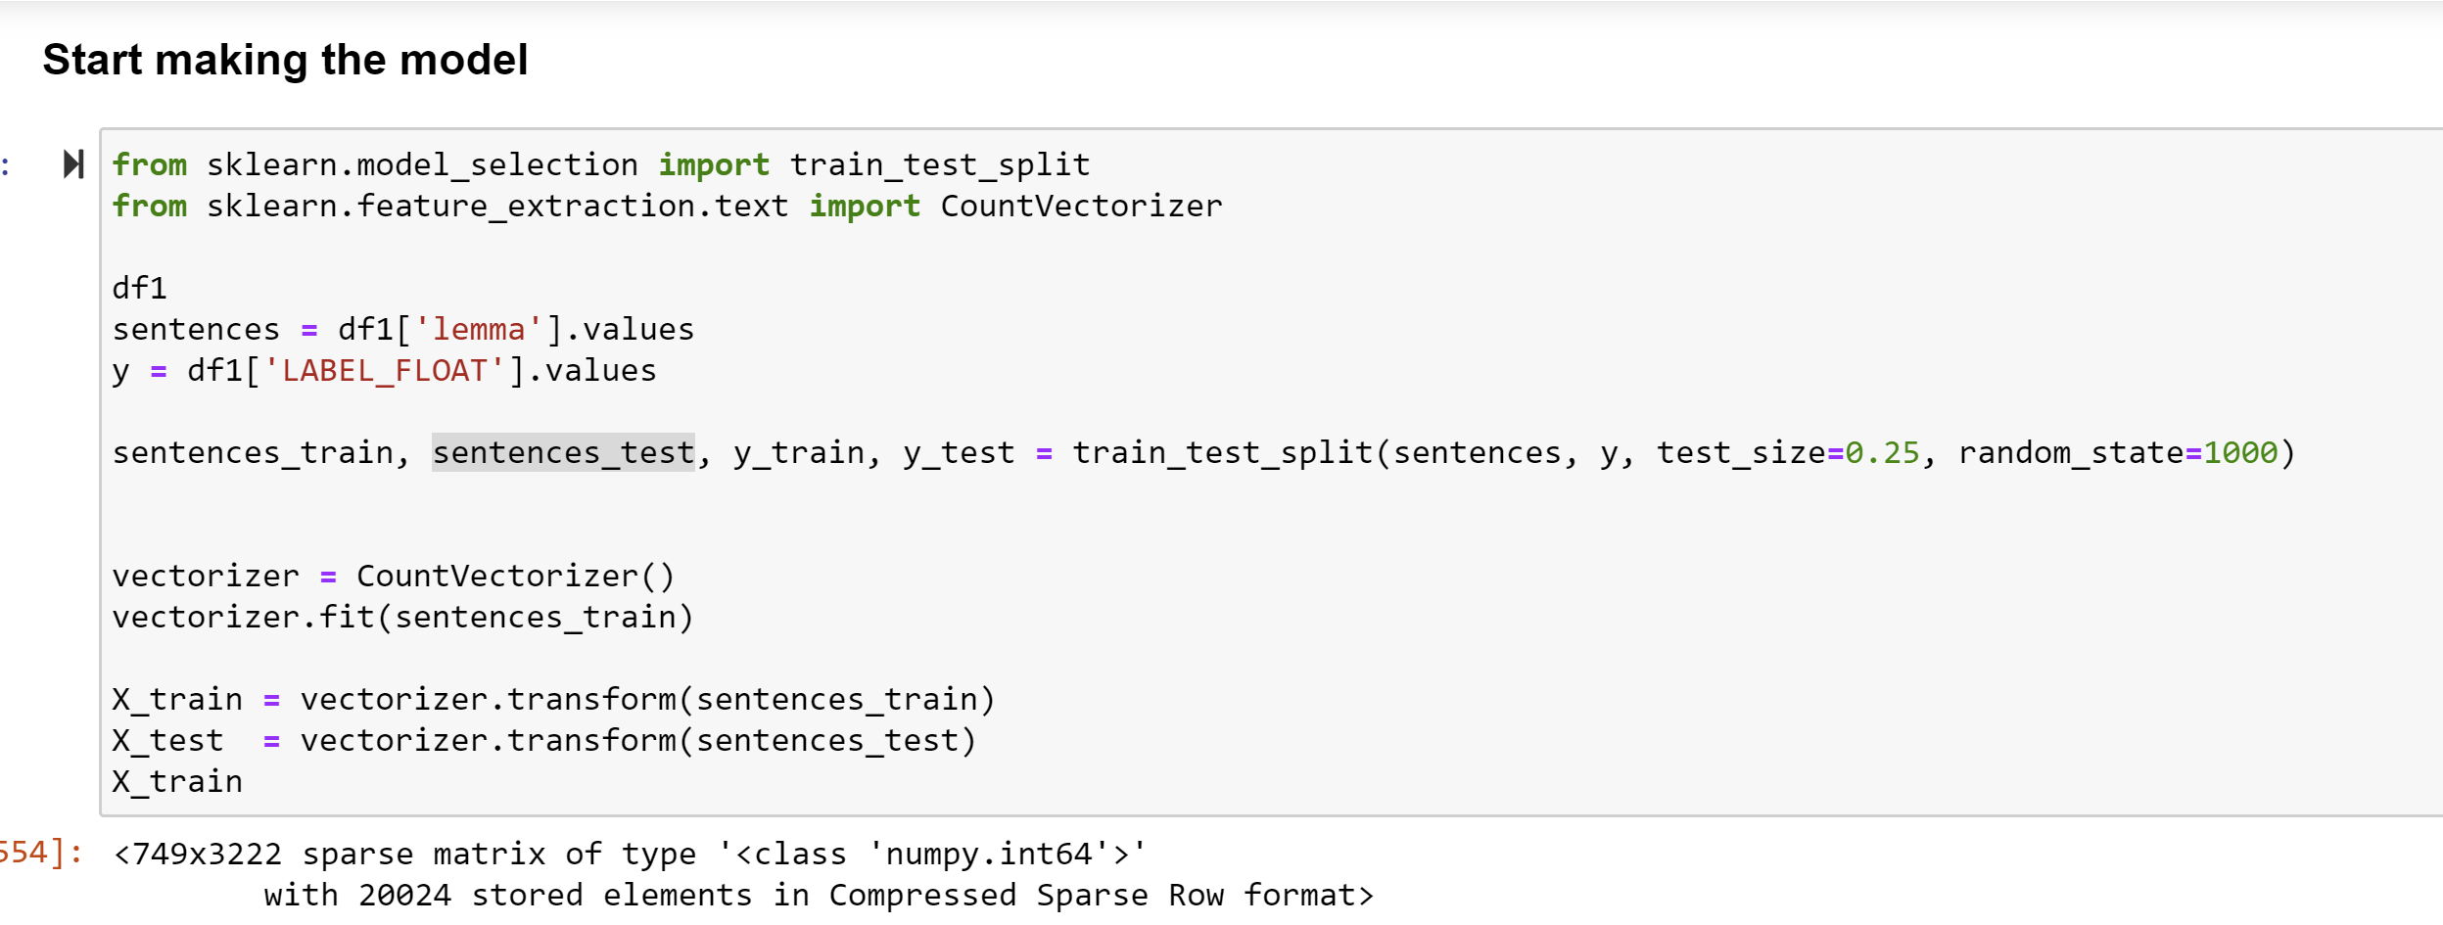
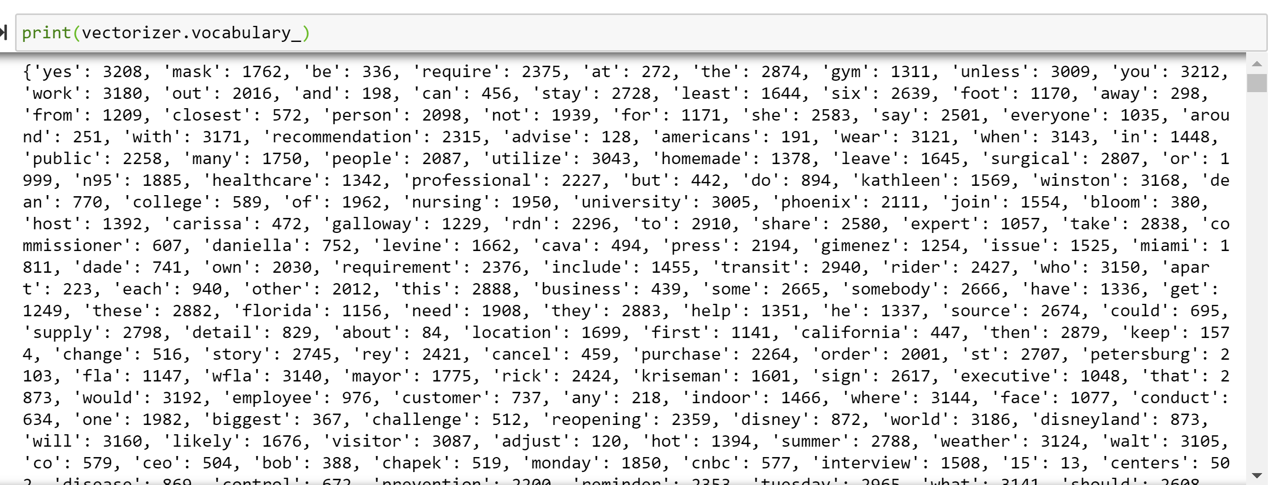
Beginning to Make the Model
Manipulate Data
We need to split data into test and train
CountVectorizer
Basically, CountVectorizer is used to convert a collection of text documents to a vector.

Slide 10
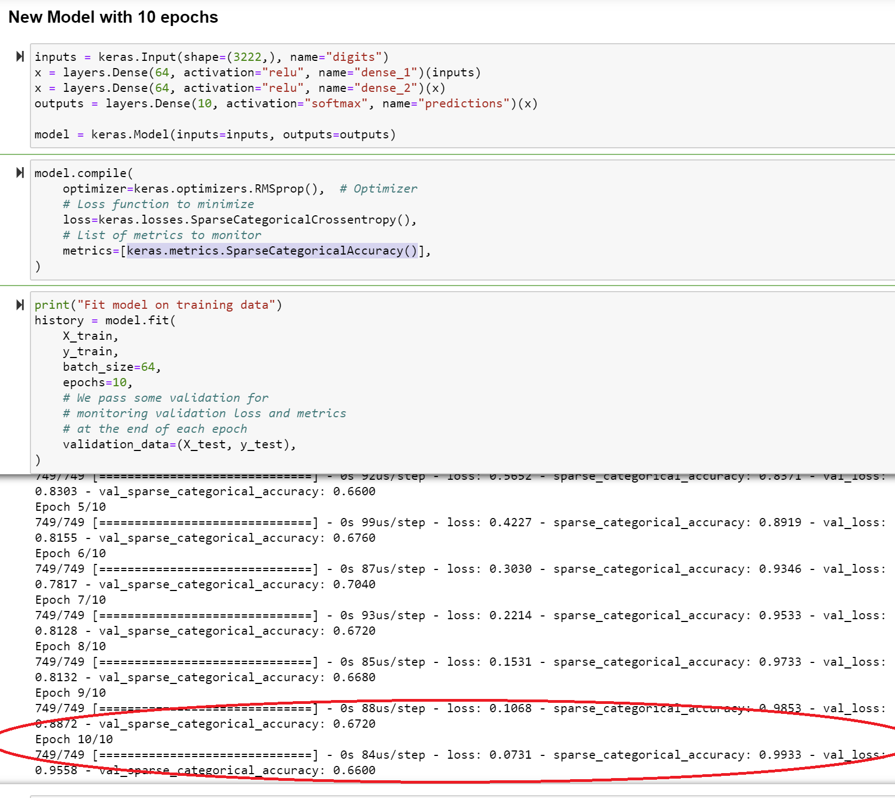
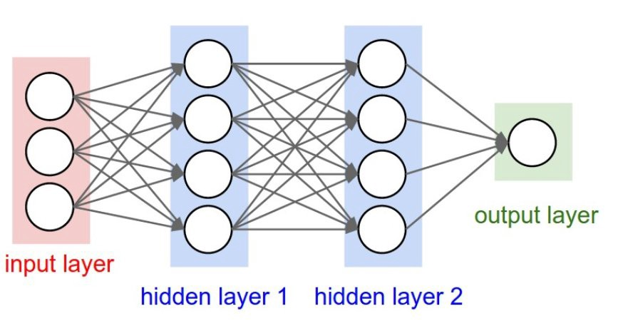
Meat of the Model
Let’s break this down!
What is “model” mean
Split data into test & train
“inputs” are CountVectorization words
the “output” is the predicted label (YESMASK, NOMASK, or NEUTRAL)
What happens in the middle?
Black box mathematics ☺

Slide 11
Meat of the Model - cont’d
What is sparse_categorical_accuracy?
Computes the frequency of the predicted “LABEL” matching the actual “LABEL”, and then divides total by count .
So what is going on here?
In a nutshell, what is going on right now is that the model is overfitting and the test data accuracy is decreasing a little because of the overfitting

Slide 12
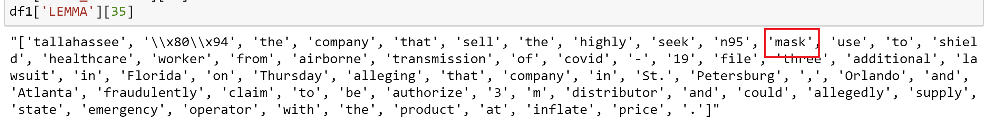
Improving Model and Accuracy
“Mask” +- 8
Only pulled 8 strings before & after the word “mask”
Used the lemmatized list to pull out the +-8 strings
This ultimately improved accuracy because it reduced noise from additional/unnecessary text
Recap:
Lemma Column
Mask +-8 Column

Slide 13
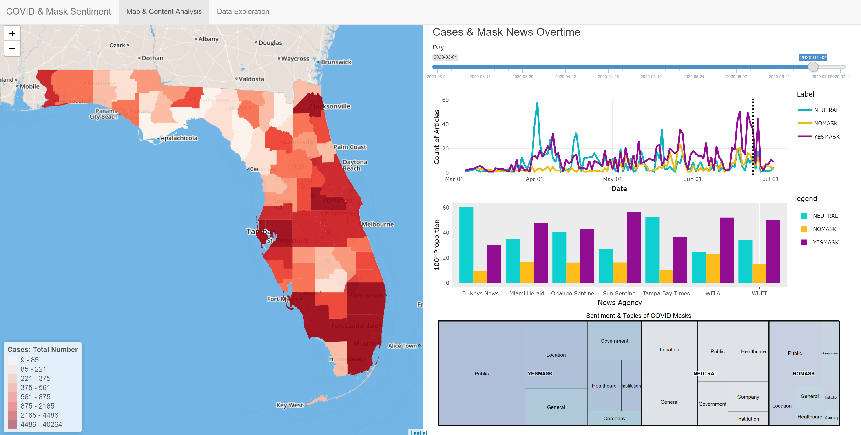
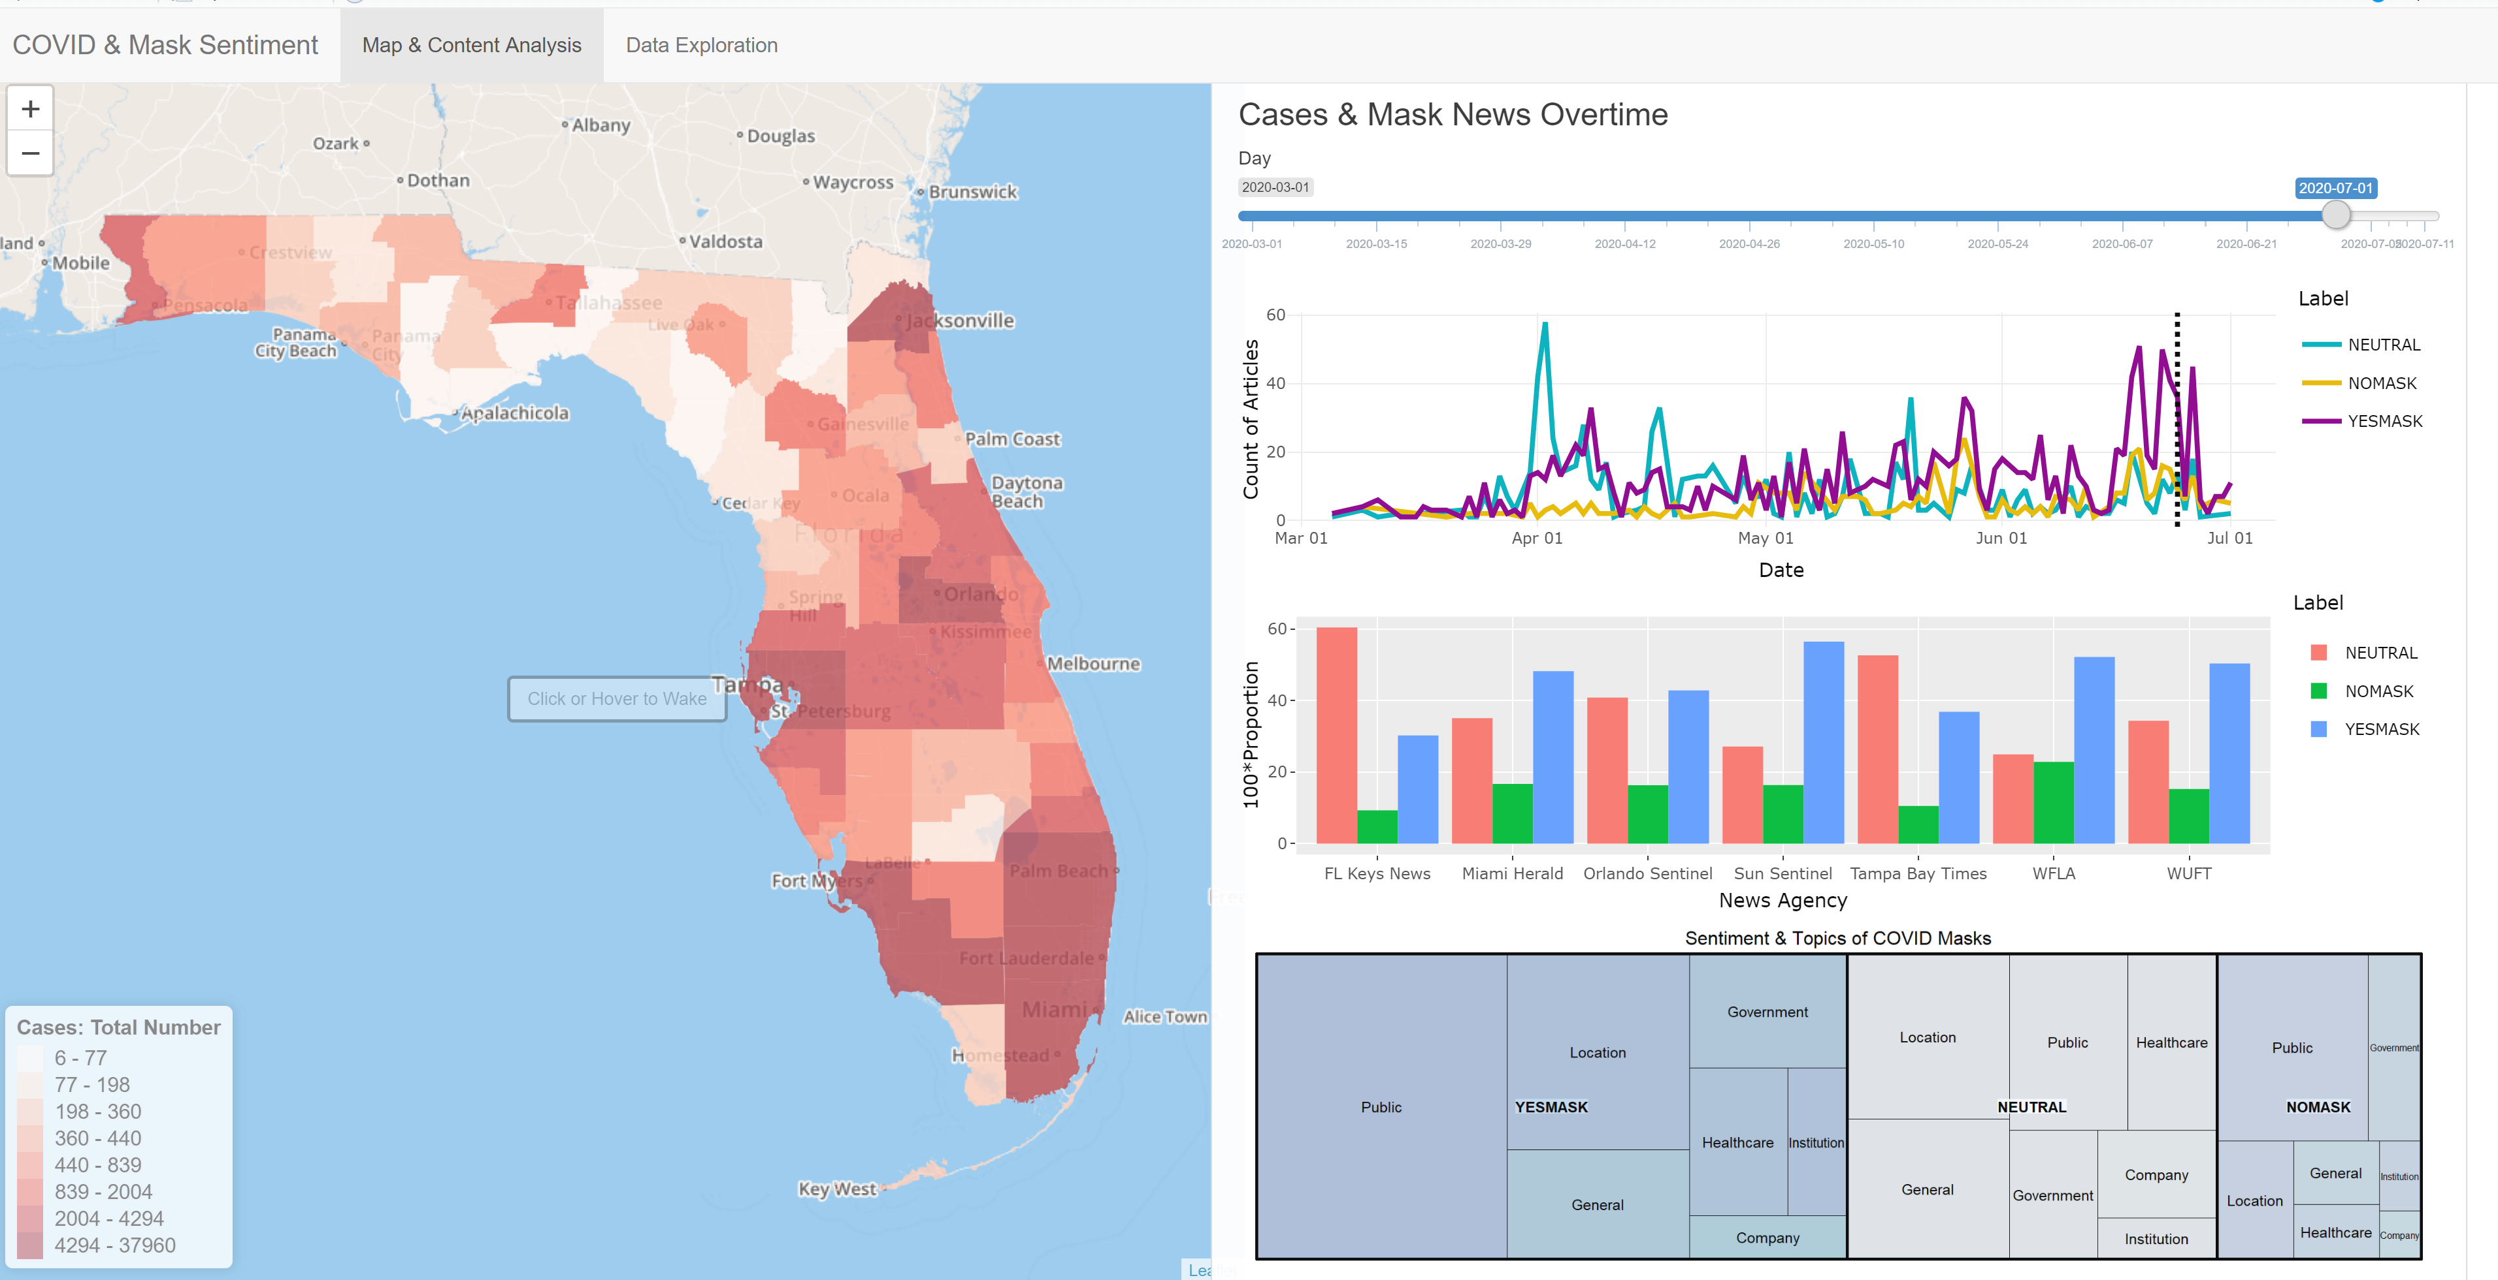
Dashboard Glimpse

Slide 14
Next Steps & What I Learned
Next Steps
Look at Twitter content
This would allow for more personalized views on masks
Would probably get a wider representation of sentiments
What I learned
Labeling is not black & white
Learned how to use RPA (UiPath) and AWS Sagemaker Labeling
Stanford NLP
NLP is fascinating
I plan to look further into how others have implemented Stanford NLP

